Slide 1

Analysis of Pretrained Word Embedding Models for Detecting AI-Generated Text
Moroti Sonde - R11904541
Sruthi Mandalapu - R11906160
Charishma Rathan Bala - R11908154
Chandrika Kancheti - R11908347
Gowtham Edumudi - R11912904
Raga Poojitha Kinthada - R11902142

Slide 2
TABLE OF CONTENTS
Abstract
Introduction
Motivation
Datasets
Methodology
Word Embeddings
Architecture
Results
Conclusion

Slide 3
INTRODUCTION
The rapid integration of artificial intelligence (AI) into various facets of life has led to significant advancements as well as new challenges, particularly in the education sector.
One of such challenge is the rise of AI-generated text, which has become increasingly more challenging, leading to difficulty in identifying human and machine-written content, replication of work by authors etc.
Today, AI systems such as GPT-3 can mimic human creativity and writing style, which can often be indistinguishable by most people.
To address this issue, our project focuses on the utilization of deep learning models and pre-trained word embeddings to detect AI-generated text effectively.

Slide 4
MOTIVATION And Objectives
With the continuous advancement of AI technologies, there is an increasing concern regarding the reliability and genuineness of written material, as AI-generated text may become impossible to differentiate from text produced by humans. This presents difficulties for educators and institutions responsible for upholding academic honesty and integrity.
Objectives:
Implementation of Bidirectional Long Short-Term Memory(Bi-LSTM) model in Identifying AI-generated Text.
Evaluation of performance of Word2Vec and Glove using Accuracy and Precision.

Slide 5
Methodology: Data collection & Preprocessing
This work uses 2 open-source dataset publicly available on Kaggle[1][2].
In this work, the dataset consist of 28828 texts, 14414 AI-generated and 14414 human written text. Along with the AI model and the prompt used in generating the text.
Preprocessing:
Tokenization
Removal of stop-words
Lemmatization of words
Removal of special characters and digits.

Slide 6
Methodology - Data Splitting:
Training set = 70%=20179
Dataset=28828
Testing set = 15% = 4324
Validation set=15% = 4325

Slide 7
Word Embeddings – Word2vec and glove
What are Embeddings:
Word Embeddings are techniques used in Natural Language Processing where words or phrases are mapped to vectors of real numbers. They help to capture semantic meanings, syntactic similarity, and relation with other words.
Word2Vec:
Developed by Google
Maps words into a high-dimensional space using two architectures (CBOW and Skip-Gram).
Effective in capturing word associations from large datasets, making it suitable for tasks like word prediction and sentence completion.

Slide 8
Word Embeddings – Word2vec and glove
Glove:
Developed by Stanford
Aggregates global word-word co-occurrence statistics from a corpus.
Combines the benefits of matrix factorization and local context window methods, offering a robust representation of word similarity.
Role of Embeddings in the Project:
For converting textual data into vector representation
These vectors serves as input features for the Bi-LSTM model, helping the understanding and classification of text sequences as AI-generated or human-generated.
Combines the benefits of matrix factorization and local context window methods, offering a robust representation of word similarity.

Slide 9
Model Architecture:
Text Preprocessing
Pretrained Embeddings
(Word2Vec & Glove)
Input Data
Data Splitting
Tokenization
Train set 70%
Remove stop words
Lemmatization
:
:
Word embeddings
Test set 15%
Val data 15%
Classifier
Embedding Layer
Performance Evaluation
Model Training
Bi-LSTM
Sigmoid

Slide 10

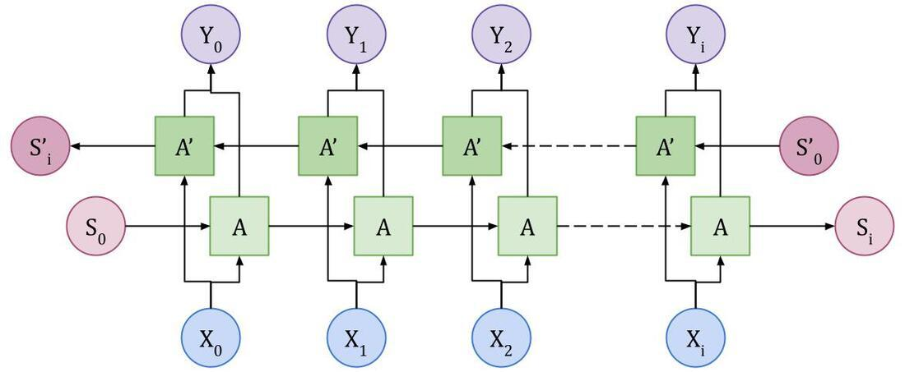
Bi-lstm Model
Bi – LSTM Model: A term used for a sequence model which contains two LSTMs. One for processing input tokens in the forward direction and the other for processing in the reverse direction. Then returns a probability vector as final output and the final output is the combination of both of these probabilities.
Architecture:
Embedding Layer: input_dim = len(word_index) + 1
Bi-LSTM Layer: 200Units,dropout=0.5,recurrent_dropout=0.3
Output Layer: Sigmoid activation function

Slide 11
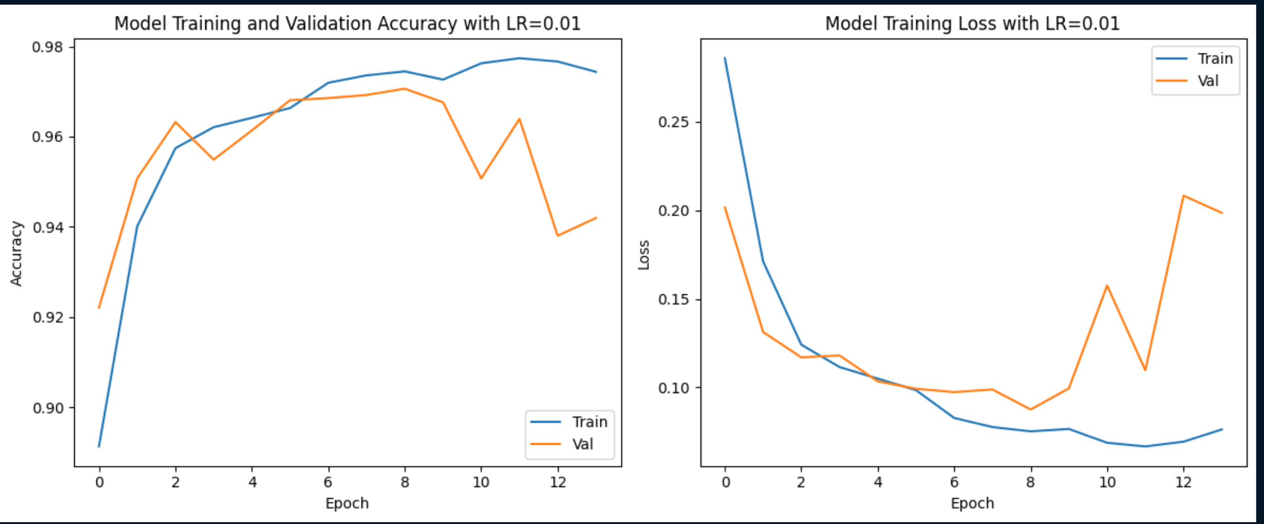
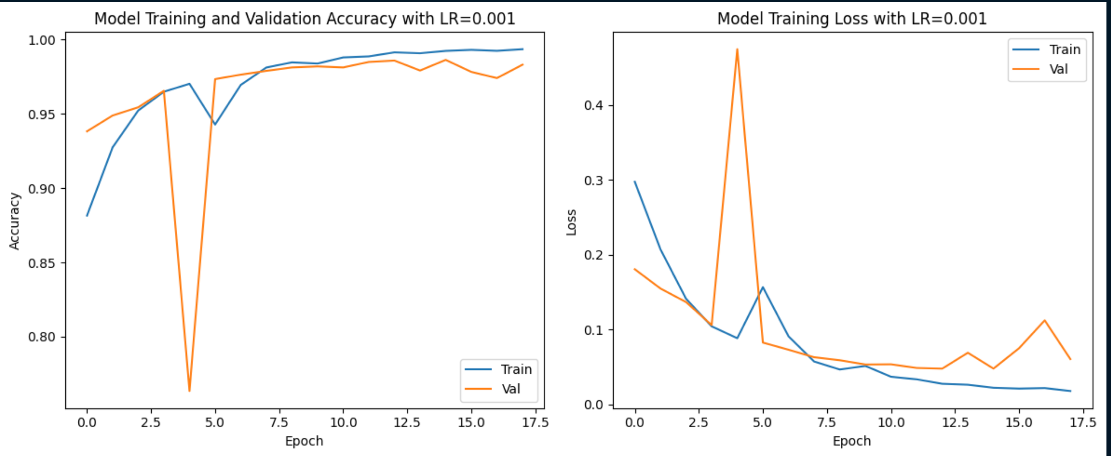
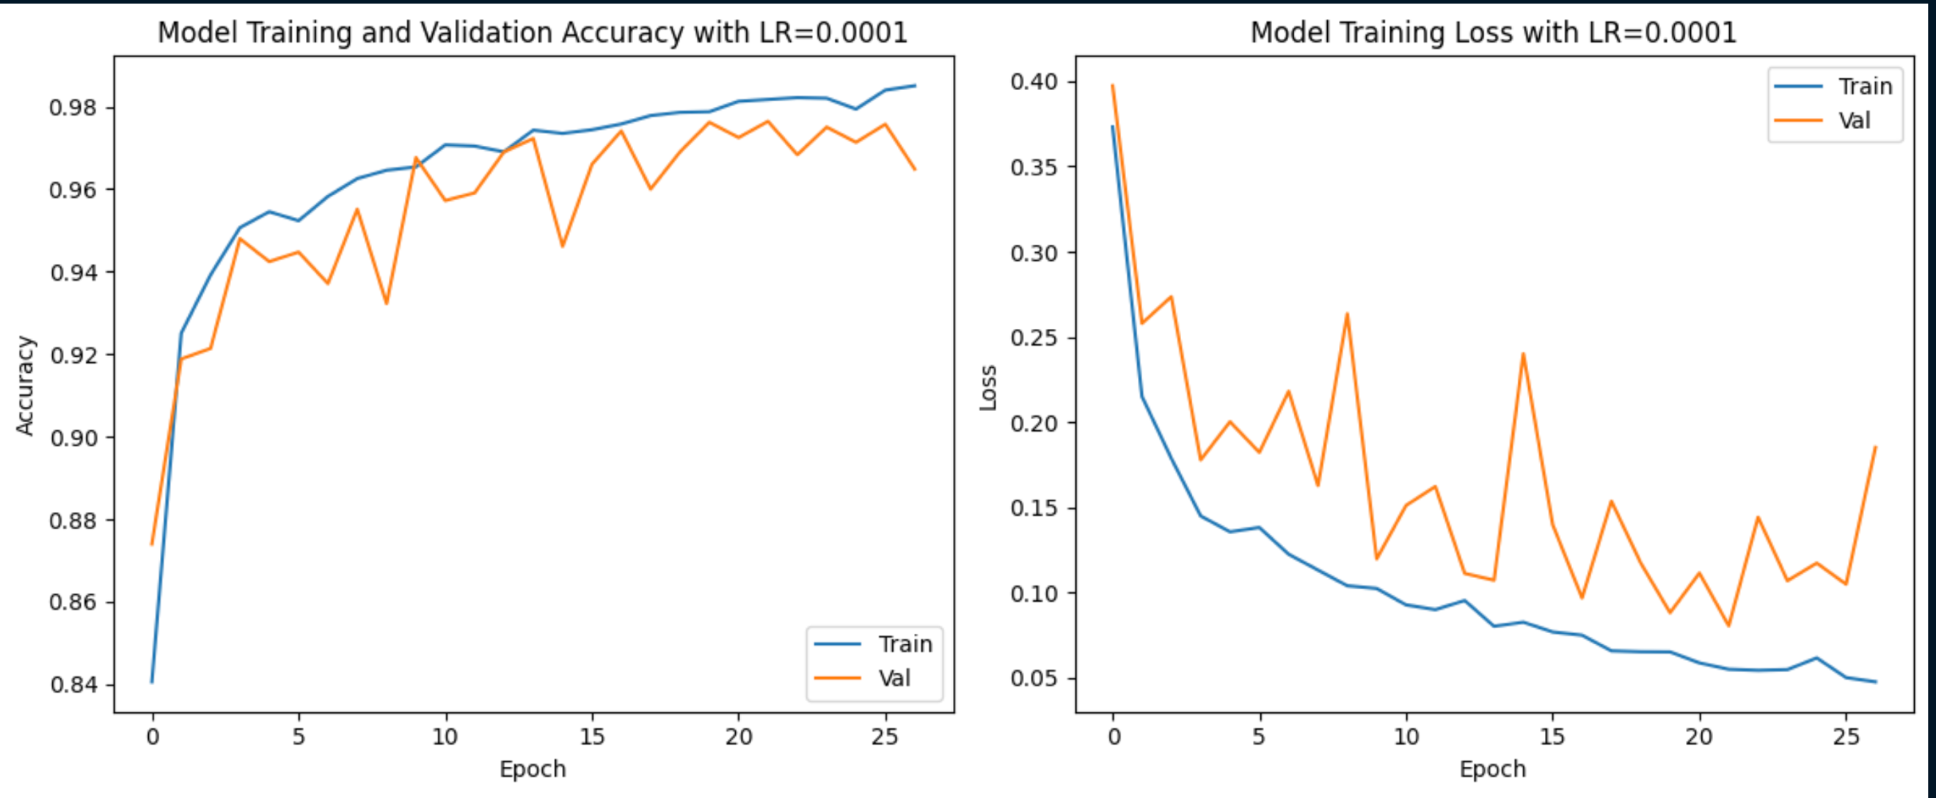
Results for Glove

Slide 12
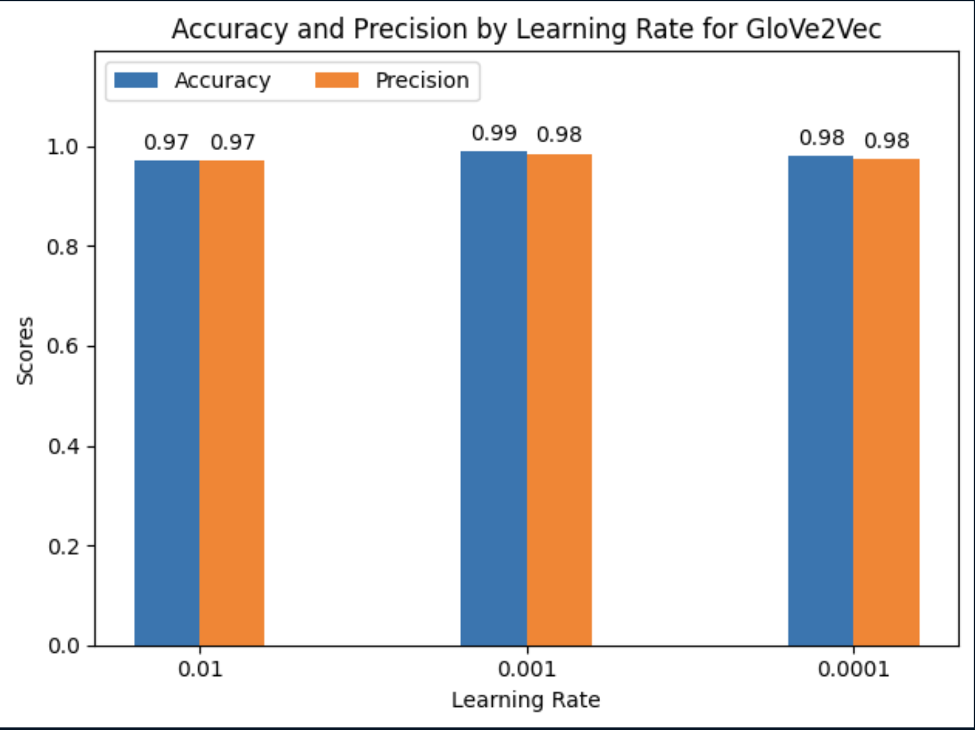
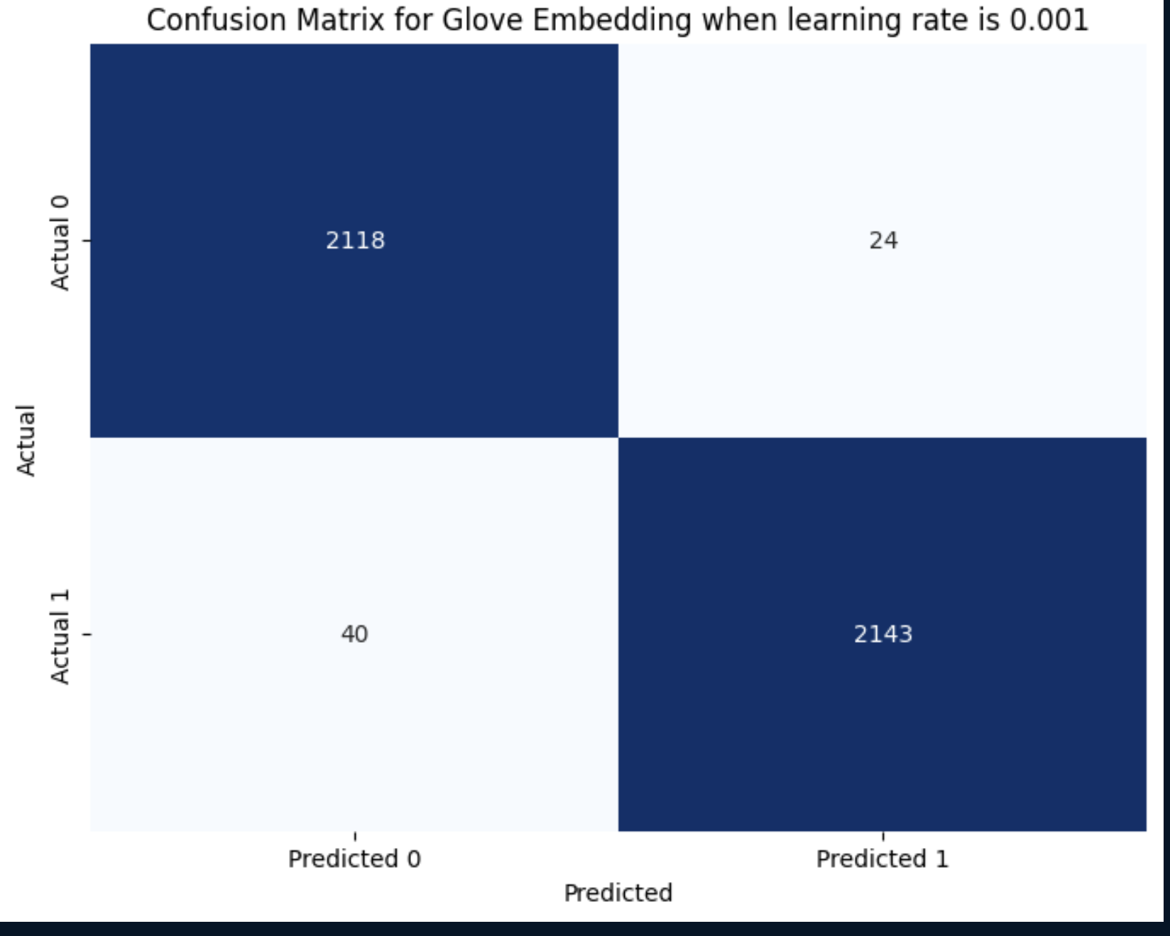
Results for GLove

Slide 13
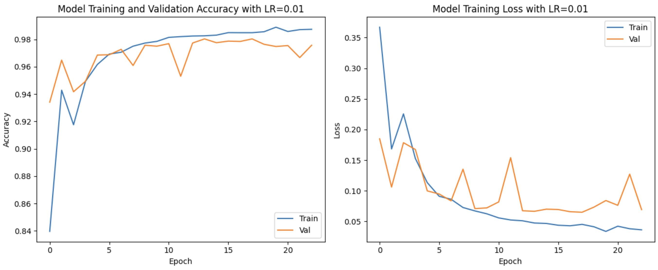
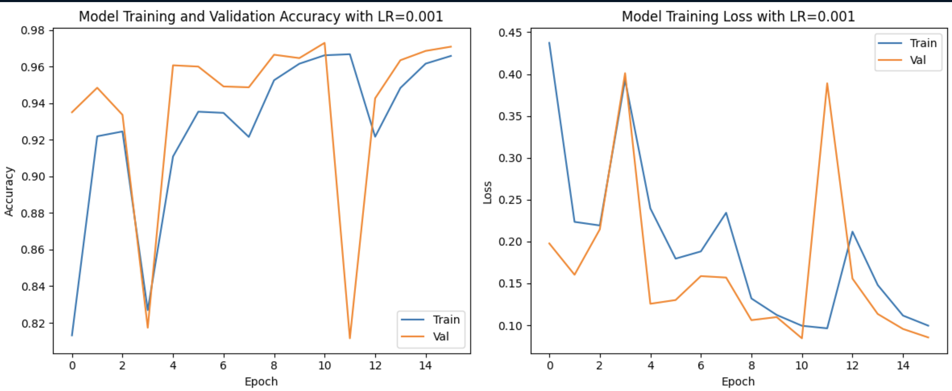
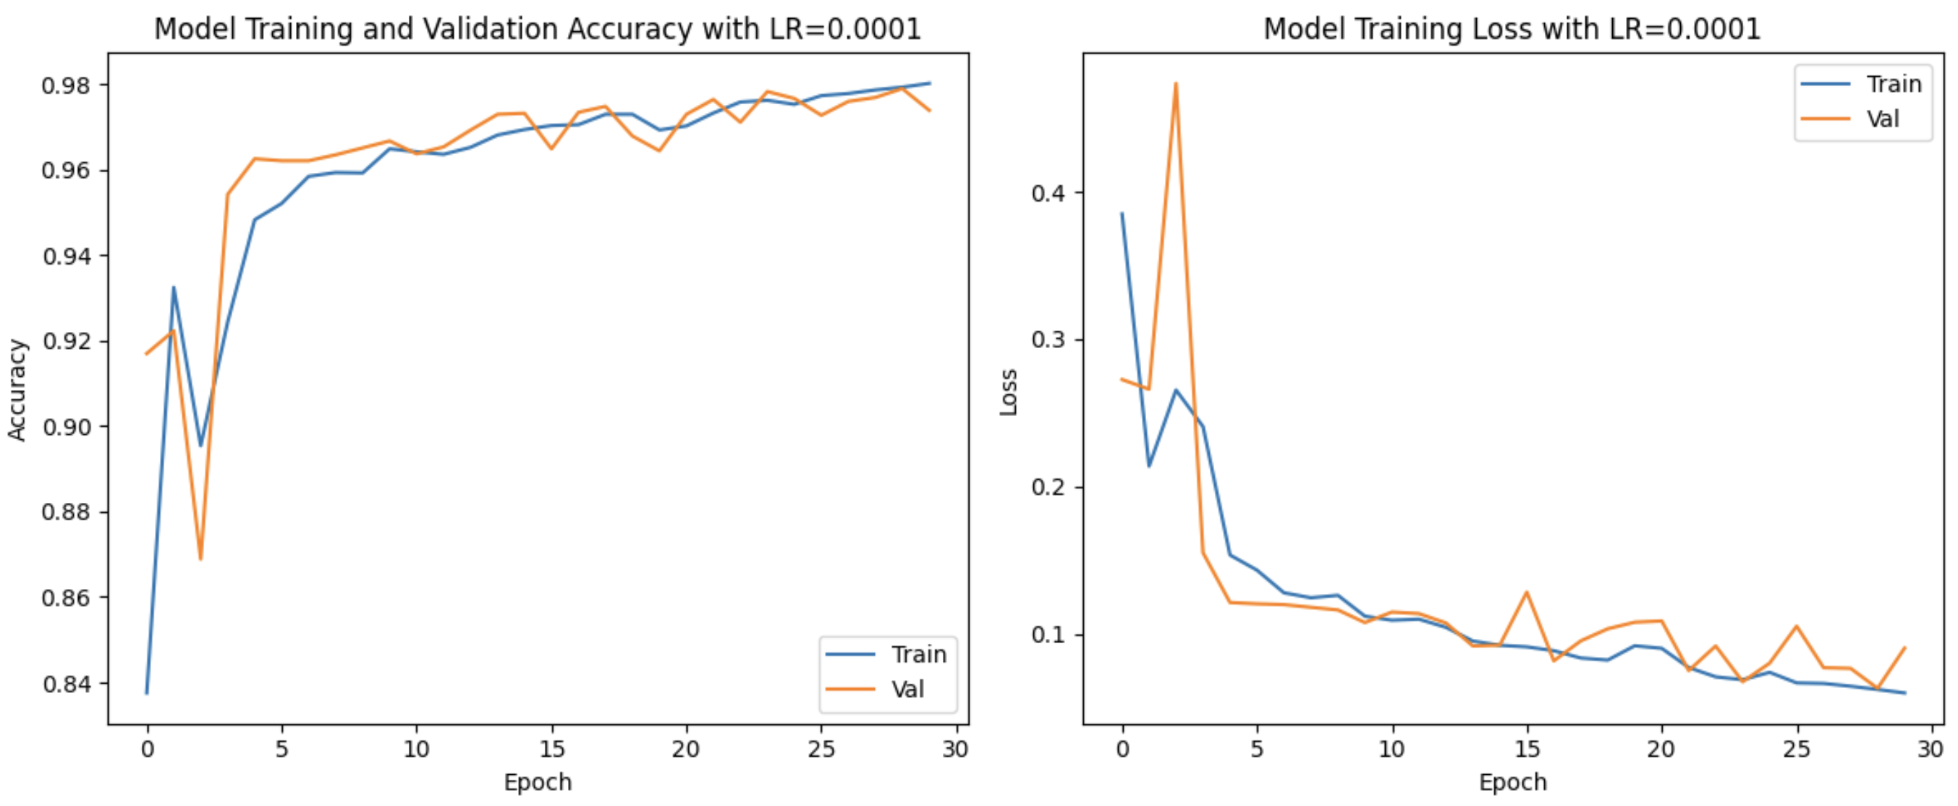
Results/Analysis for word2vec

Slide 14
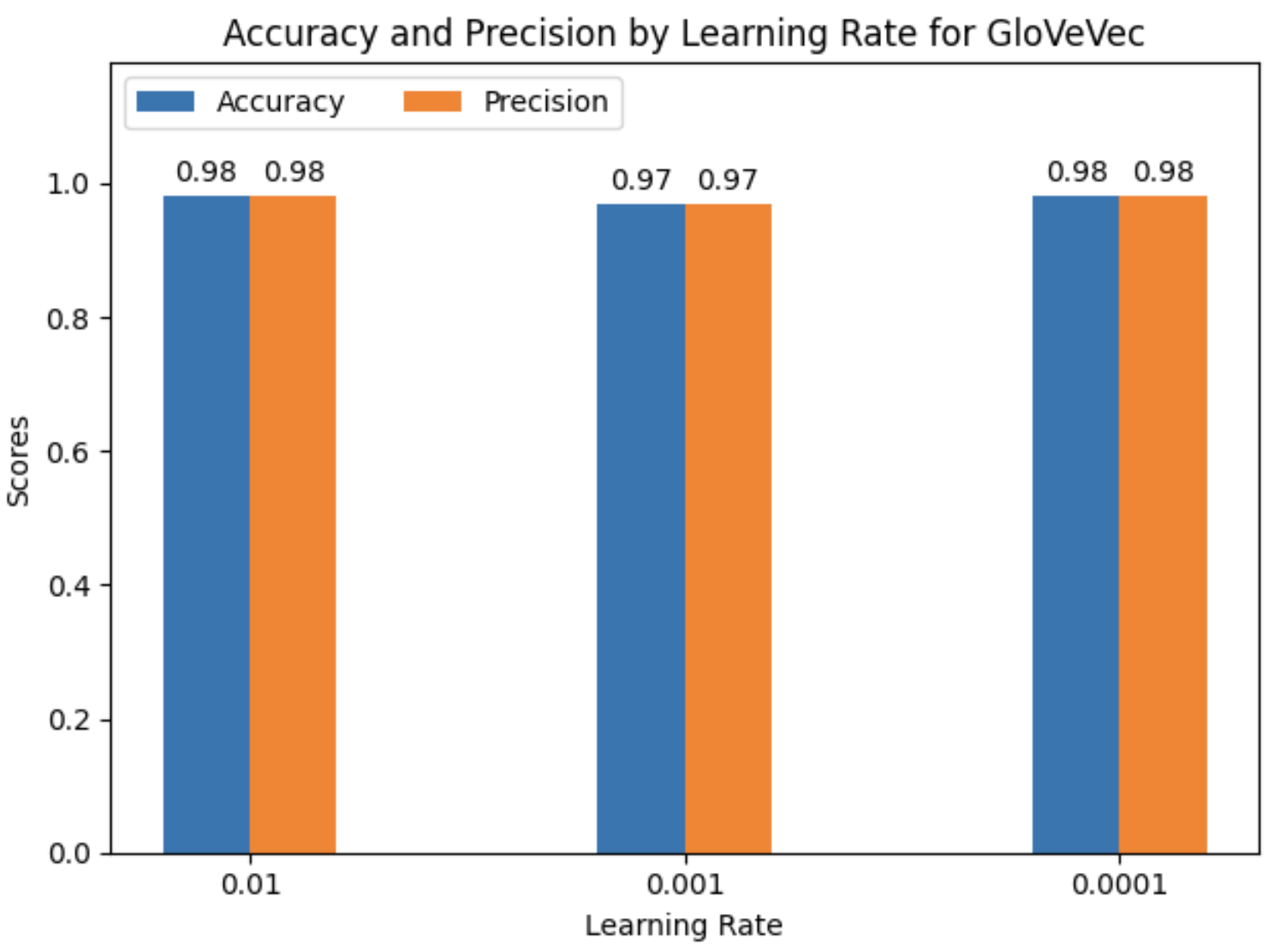
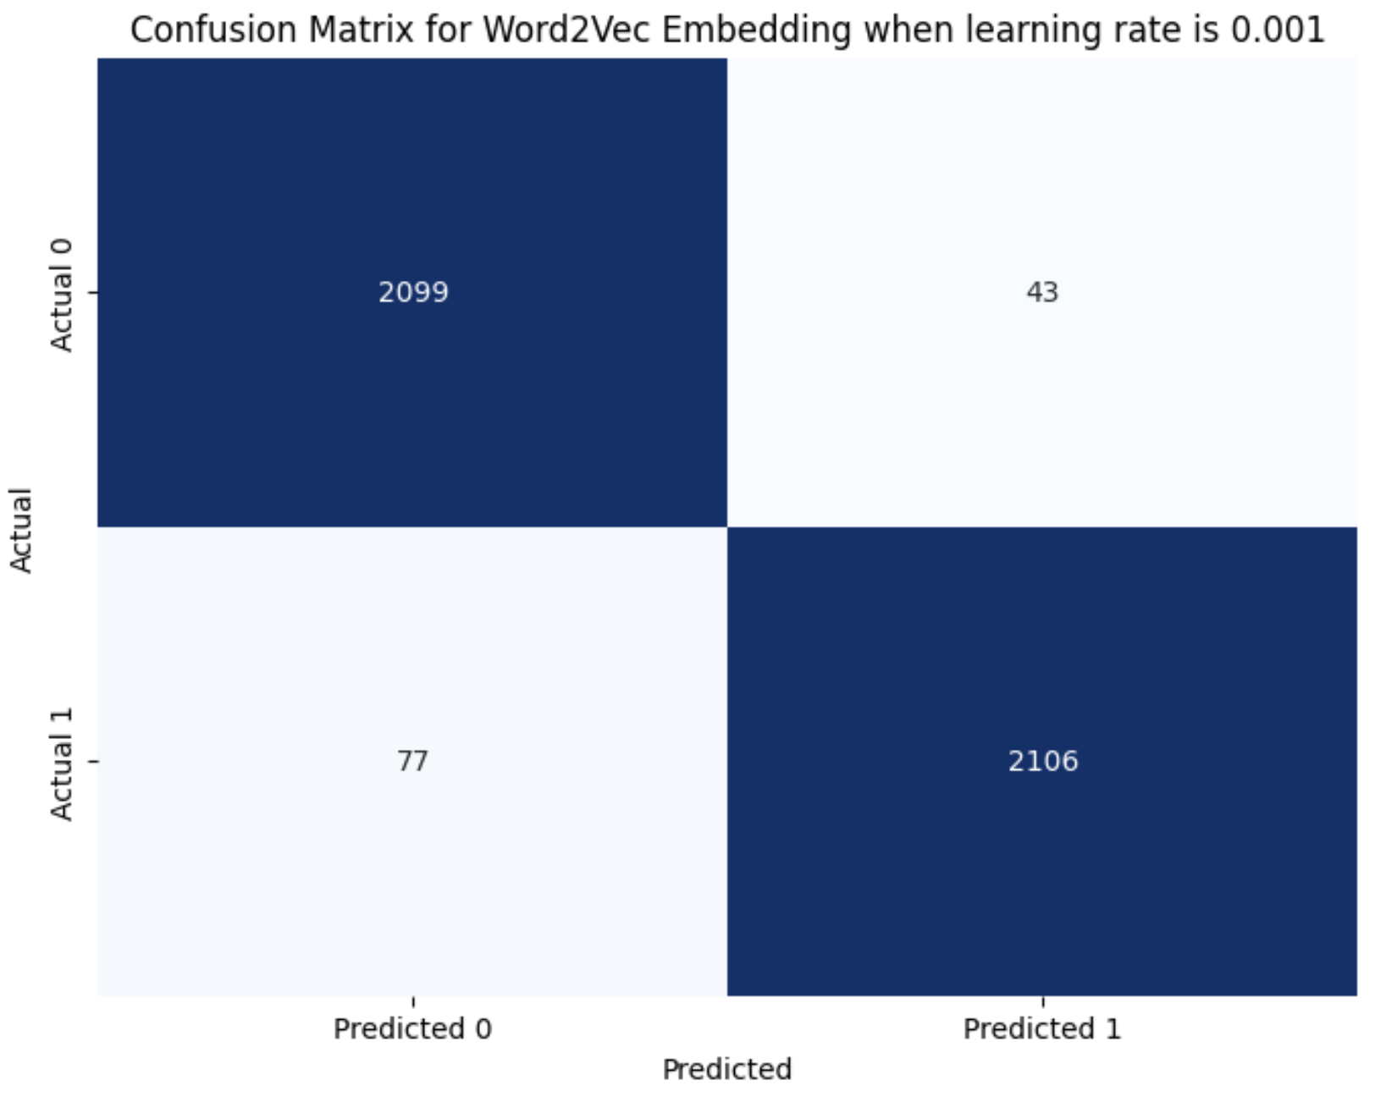
Results/Analysis for Word2vec

Slide 15
Discussion & Limitations
Both Word2vec and GloVe showed promising results in distinguishing between AI-generated and human-generated text, which is crucial in maintaining academic Integrity and honesty. The findings can be applied to develop tools that help educators detect AI-generated assignments, enhancing. Fairness in academic evaluations.
Limitations:
Bi-LSTMs, although powerful but are complex and can be challenging to interpret, which may limit their practical applicability without substantial expertise.
The model might not perform as well when exposed to text significantly text written by children or evolving language usage.
Computational resources.

Slide 16
CONCLUSION & Future work
Summary:
The project shows that using Word2Vec and Glove embeddings with a Bi-LSTM model effectively identifies AI-generated and human-generated text.
The models achieved notable accuracy and precision, demonstrating their utility in educational contexts for detecting AI-generated content.
Recommendations for Future :
Expanding the datasets to include more varied samples, such as essays by children, to test robustness.
Addressing potential ethical issues, such as impact of false positives on students, should be a priority.
Exploring other models

Slide 17
REFERENCES
1. https://www.kaggle.com/datasets/thedrcat/daigt-proper-train-dataset/
2. Jules King, Perpetual Baffour, Scott Crossley, Ryan Holbrook, Maggie Demkin. (2023). LLM - Detect AI Generated Text. Kaggle. https://kaggle.com/competitions/llm-detect-ai-generated-text.

Slide 18
THANK YOU

